Slide 2
Year 12 exam
These are the OCR theorists you should have some knowledge of
MEDIA LANGUAGE
Todorov
Levi-Strauss
Neale
Baudrillard
Barthes
INDUSTRY
Hesmondhalgh
Curran & Seaton
Livingstone & Lunt
Narratives have a 3 part structure. Disruption is the main stage.
Gender is performance, a set of rituals. It is based on conditioning by certain expectations, values & attitudes. Performativity.
we live in a jungle of signs and symbols Audiences play a part in reading these signs.
If it doesn’t spread it’s dead.
Fandom keeps texts alive.
The only form of reality we are familiar with is the world of media representation – a world of simulation & imitation. Intertextuality is an aspect of this.
Female representations reflect our patriarchal society. Media reflects dominant male, patriarchal values
Genre is instances of repetition & difference
Narratives consist of contrasting themes. One of these is always dominant in a narrative.
Women are discriminated against in many ways, depending on class and ethnicity.intersectionality
Media is controlled by large corporations who play safe & avoid risk to maximise profits.
Producers encode messages through media language. Audience decode meaning meaning in 3 main ways.3 readings
AUDIENCE
Gerbner
Shirky
Jenkins
Over time, we become desensitised to media effects. Media can also give us a falsely pessimistic view.
The power of media organisations and concentration of ownership acts against pluralism, diversity and free speech. It perpetuates hegemony Capitalist consumerist attitudes become the norm.’Power without responisbility’ .
Media is participatory (shared).- Social global ubiquitous & cheap.It’s one big ‘many to many’ converstaion. Everyone is a producer (prod-user/pro-sumer)
REPRESENTATION
Van Zoonen
Butler
Hall
hooks
The pluralist digital media landsape makes it hard to regulate media content.

Slide 3
Narratives have a 3 part structure. Disruption is the main stage.
we live in a jungle of signs and symbols Audiences play a part in reading these signs.
Todorov
Gender is performance, a set of rituals. It is based on conditioning by certain expectations, values & attitudes. Performativity.
Barthes
Butler
If it doesn’t spread it’s dead.
Fandom keeps texts alive.
Female representations reflect our patriarchal society. Media reflects dominant male, patriarchal values
The only form of reality we are familiar with is the world of media representation – a world of simulation & imitation. Intertextuality is an aspect of this.
Jenkins
Baudrillard
Van Zoonen
Genre is instances of repetition & difference
Women are discriminated against in many ways, depending on class and ethnicity.intersectionality
Neale
Narratives consist of contrasting themes. One of these is always dominant in a narrative.
Levi-Strauss
hooks
Producers encode messages through media language. Audience decode meaning meaning in 3 main ways.3 readings
Media is controlled by large corporations who play safe & avoid risk to maximise profits.
Hesmondhalgh
Hall
The power of media organisations and concentration of ownership acts against pluralism, diversity and free speech. It perpetuates hegemony Capitalist consumerist attitudes become the norm.’Power without responisbility’ .
Over time, we become desensitised to media effects. Media can also give us a falsely pessimistic view.
Gerbner
Media is participatory (shared).- Social global ubiquitous & cheap.It’s one big ‘many to many’ converstaion. Everyone is a producer (prod-user/pro-sumer)
Curran & Seaton
Shirky
Livingstone & Lunt
The pluralist digital media landsape makes it hard to regulate media content.

Slide 4
Fandom
Intersectionality (mutiple forms of discrimination)
Levi-Strauss
Jenkins
contrasting themes.
hooks
Van Zoonen
simulation & imitation. Intertextuality
Hesmondhalgh
Baudrillard
corporations who avoid risk
patriarchal values
Hegemonic -’Power without responisbility’ .
Curran & Seaton
Neale
repetition & difference
Disruption
Todorov
Desensitised & pessimistic view.
Performativity.
3 readings
Hall
Butler
Gerbner
hard to regulate
a jungle of signs and symbols
Participatory)
Livingstone & Lunt
Shirky
Barthes
https://www.classtools.net/random-name-picker/87_3YDShH
Wheel spinner

Slide 5
News media revision – Tuesday 9th June
THE GUARDIAN – INDUSTRY & MEDIA LANGUAGE

Slide 6
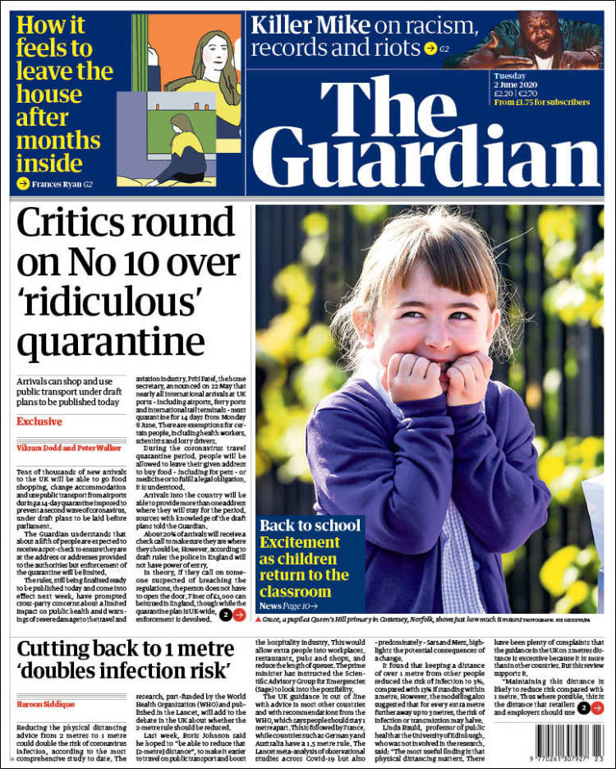
The Guardian – an alternative voice
Industry + language
MEDIA INDUSTRIES
broadsheet
Scott Trust (charity)
Funding? (ads + reader subscription, donations + cover price)
Political affiliation? Lab / Lib-dem
Target audience? AB, educated, idealists, ‘reformers’
Mode of address and how we know? formal
Main stories
Lockdown lifting slowly; some primary classes are back after 10 weeks
Criticism of government policy of making people coming into the UK go into 14 days quarantine.
Race riots in the US after another case of police brutailty.
Other aspects of media language
Use the correct terminology!
Layout Caption columns Standfirst Skyline Jumplines Masthead Sell lines
Colour palette mode of address
house style Typeface
Lower/upper/ middle third
Comment on use of quotation marks in the headlines

Slide 7
concentrate on print newspapers, not digital, for the exam
But you should be aware of
The advantages of digital over print media
The Mail Online’s sidebar of shame
The use of online paywalls by most broadsheet papers (Times, Guardian, Tel;egraph)
The Guardian’s yellow box and buttons messages asking for donations and subscriptions.

