Slide 1
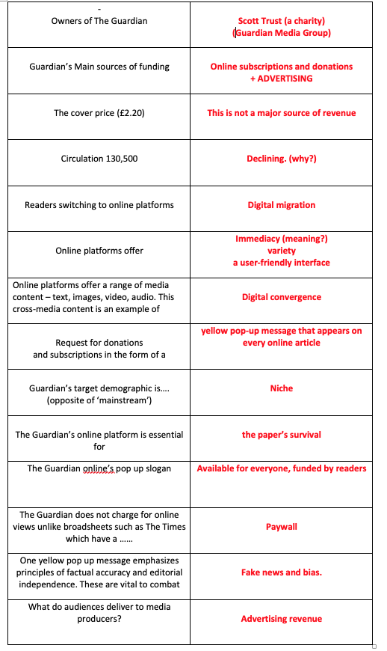
Paper One pre-mock practice
Test yourself on these
basic facts

Slide 2
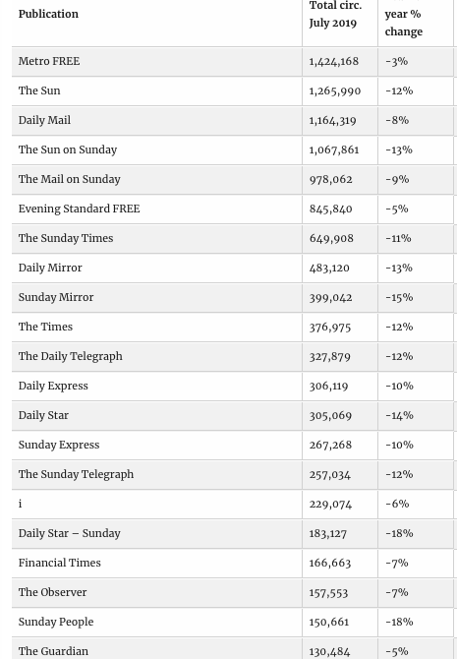
LATEST ‘ABC’ NEWSPAPER CIRCULATION FIGURES

Slide 3
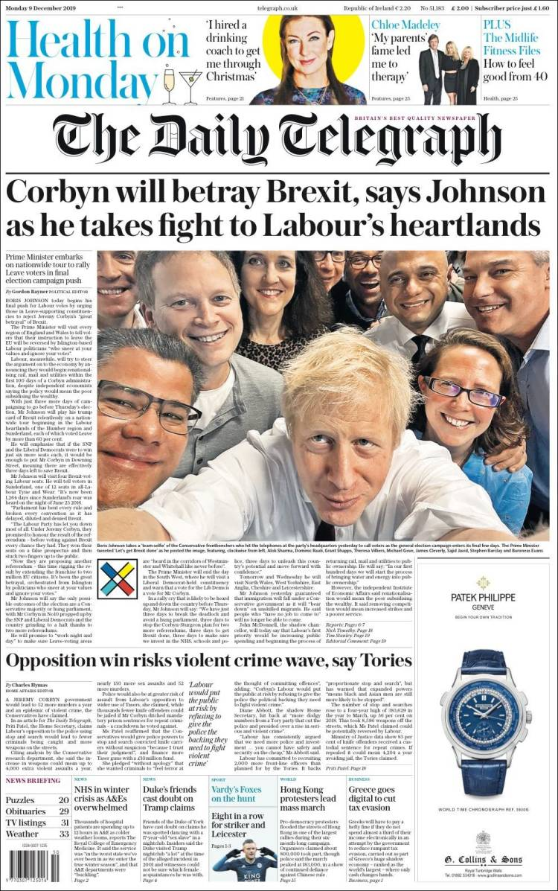
Comment on the social and cultural representations, Refer to Hall.

Slide 4
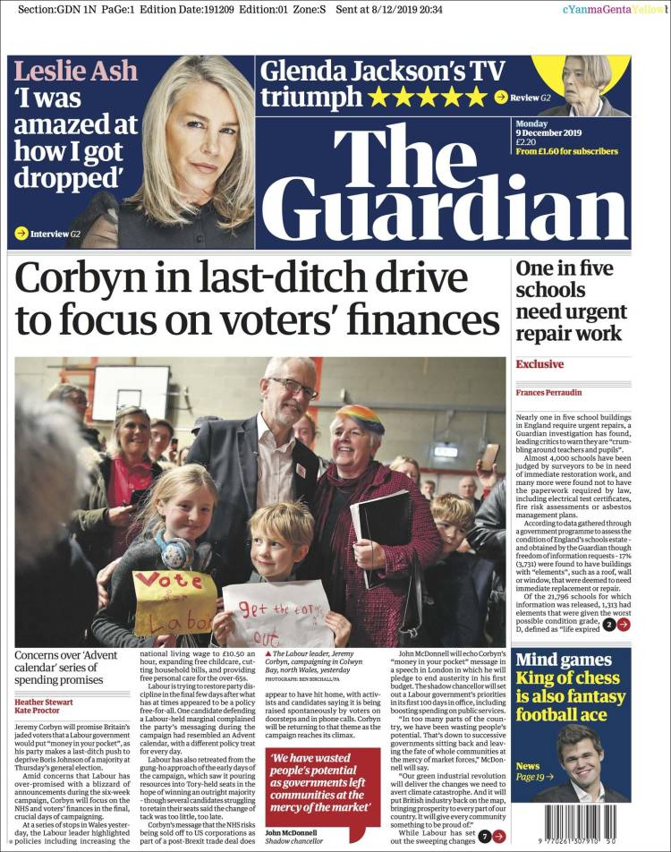
Comment on the social and cultural representations, Refer to Hall.
Feed the examiner kitten –
Put these buzzwords into sentences relevant to this front page
Encode
decode
Manipulate
Dominant
Construct
Hegemonic

Slide 5
Source A
Source B
1 Analyze the social and cultural representations in these 2 front covers from 9th Dec 2019
Refer to Hall /10 marks.
no need to hugely compare/ contrast
But your answer mustrefer to Hall seeral times
Don’t go into C&Cs too much
10 marks so 3 or 4 points for each source
Source A mention 3 or 4 of the following. Emphazise CONSTRUCTION OF REPS & IDEOLOGIES
Evidence of clear contruction of a hegemonic message or dominant reading conveys the broadheet’s political affiliation
Broadsheet: Tgph’s pro conservative stance – visible from upbeat image –e + Smiling affirmative supporters + Mainly white male but some female.
Strong middle class ABC1 feel –designed to reflect target audience
Consumerism -prominent & expensive front page ad – stylish product - a source of funding strongly features in ad
Moral panics in 2 nd front page splash about threat of crime: Taps into fears of crime- strong associations of Tories with supporting status quo. Strong bias & contruction/encoding of dominant rep.
Health features strongly in skyline banner – reflects contemporary social attitudes and links to consumerism

Slide 6
Source A
Source B
1 Analyze the social and cultural representations in these 2 front covers from 9th Dec 2019
Refer to Hall /10 marks.
no need to hugely compare/ contrast
But your answer must refer to Hall several times
10 marks so 3 or 4 points for each source
Source B
Guardian’s construction, C&Cs encode a more pro-labour view. Construction of image uses strong signifiers of community and generosity.
In terms of HALL, Encoded messages are more negotiated than dominant – the viewpoint is more restrained as encoded in the headline –’ last-ditch drive’.
Celebrity is also a possible theme as politicians now have the same status as entertainment celebs due to TV & social media
Social aspects – 2nd story is about schools –ties in with Labour’s core values on public spending
The sell lines in the skyline focus on entertainment - strong cultural content and intertextual refernece to another media platform

Slide 7
2 How far have media conventions been used to construct viewpoints in Sources A and B?
In your answer you must:
• outline the conventions of the front pages of tabloid newspapers, including use and style of headlines and images
• analyse the contrasting use of symbolic, technical and written conventions in the sources
• make judgements and reach conclusions on the way in which media conventions construct viewpoints and ideologies. /15
A more comparative answer – concentrate on language forms C&Cs and how they shape ideologies.
In depth study so bring in other theories where possible. Make about 5 or 6 points from A & B
Guardian
-Textual codes in headline are more restrained
More pro Corbyn than we would expect
Guardian unusual here in its more pro Labour stance
Both sources use news value of personalization
-Large main Image – key visual signifiers connote warmth, community, togetherness,
-more objective camera angle (flattering?)
-popular representation of supporters
Strong use of connotation (Barthes) – signs are accepted by reader & producer - Presents and children; connotes generosity & family values.
-Constructs a message about closeness to ordinary voters –Pro labour values accentuated by 2nd story about schools needing repair.
Upbeat, less alarmist (contradicts Gerbner)
C&Cs shape messages which appeal to a different target audience to Telegraph
Telegraph
visual codes show confidence, informality (perhaps arrogance high angle, taking a selfie
- close cropping suggests adoring close support
selfie = awareness of camera
Large dominant image – flattering? Positive?
Signifiers BJ is shirtsleeves Popular & informal Headline – strong emotive lang
‘fight’ heartlands’ betray; direct MoA
Alliterative Betray brexit Boris
(shows the populist nature of the Broadsheet adopting tabloid C&Cs)
Gerbner : media influences audience attitudes
Moral panics evident in 2nd splash – hegemonic dominant viewpoint

Slide 8
Pre-mock exam practice
Qu 3 how do economic factors influence the distribution and funding of The Guardian compared to other papers /10
Qu’s to help your answers
How is the ownership of the G different? Who owns it and what else do they own?
Circulation (general)
2) Role of advertising ?
3) Paywall (pay to view) or free to view?
4) Target audience – link to online yellow pop up; brand identity and brand loyalty?
WRITE NOTES BASED ON YESTERDAY’S LESSON – HIGHIGHT KEY TERMS – e.g. convergence, concentration, conglomerate, circulation, migration,
‘not for profit’, cover price, ‘not for profit’, PAYWALL, immediacy, niche, reformers, fake news, bias (unbiased, impartial), brand values,
journalistic quality/independence/ integrity (=honesty)
Now prepare the same question but replace the Guardian with the Daily Mail

Slide 9
Qu 4
Evaluate the usefulness of TWO the following when considering ONLINE newspaper audiences /10
JENKINS
HESMONDHALGH
NEALE
BANDURA

Slide 10
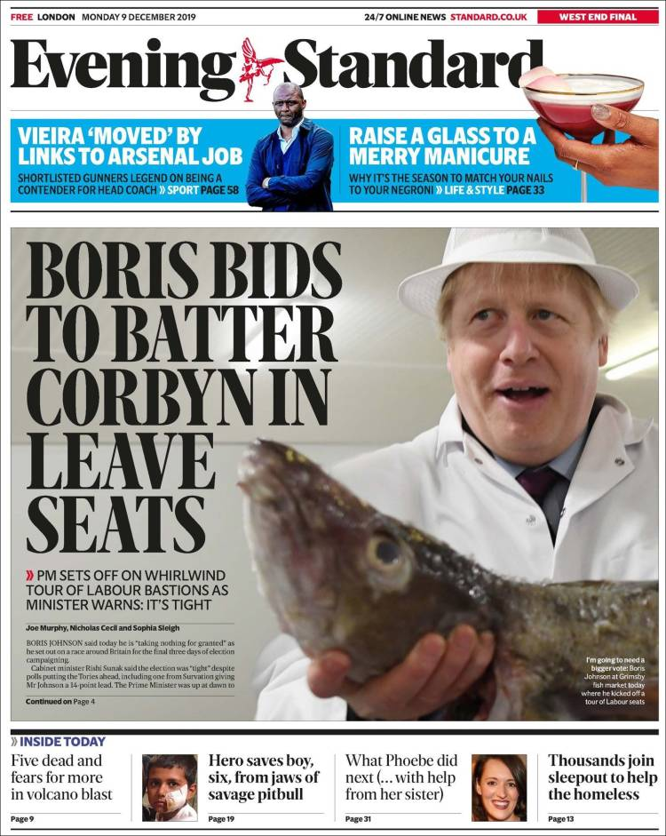
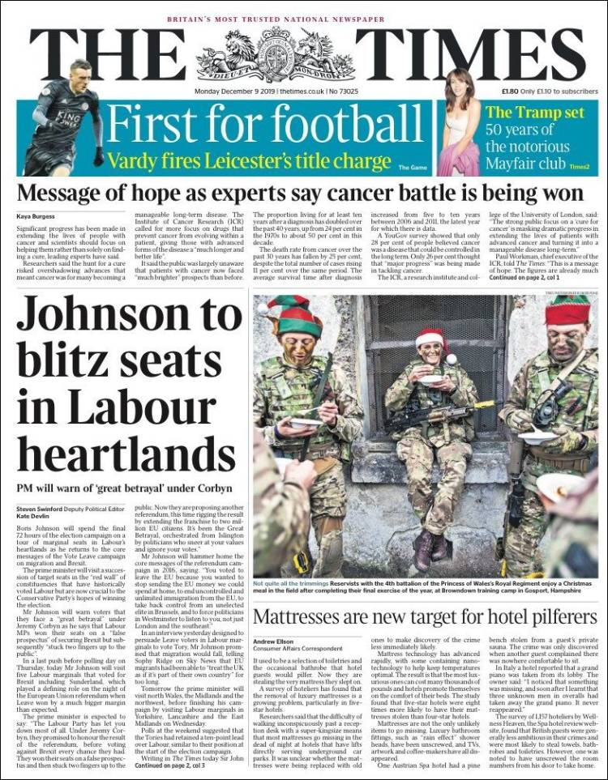
Here’s some more practice material
The Times (traditional quality broadsheet). vs The Evening Standard (free, tabloid)

Slide 11
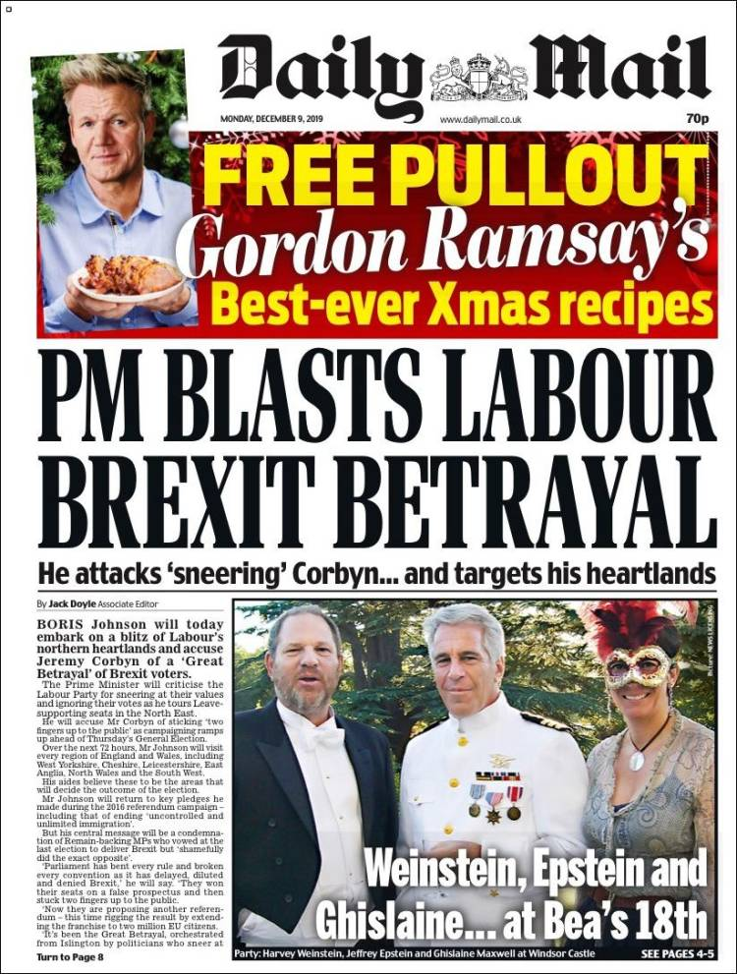
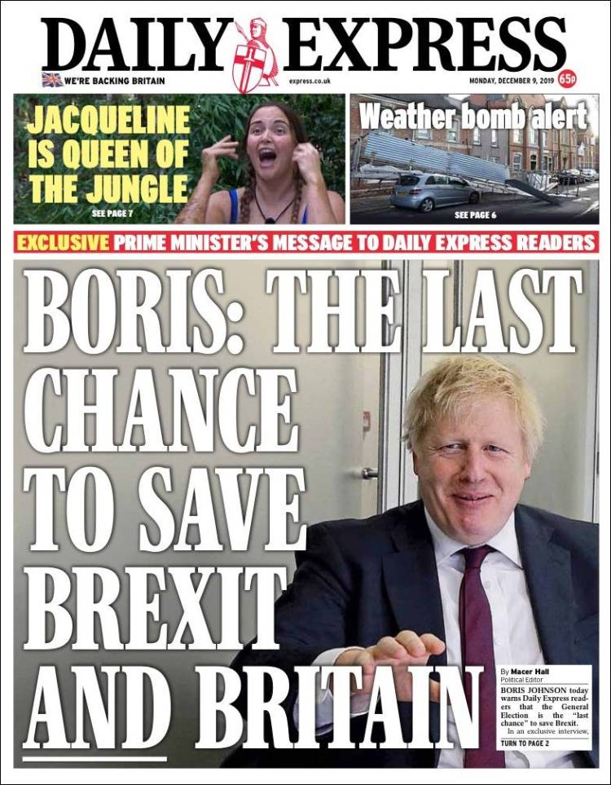
MORE TABLOIDS

