Slide 1
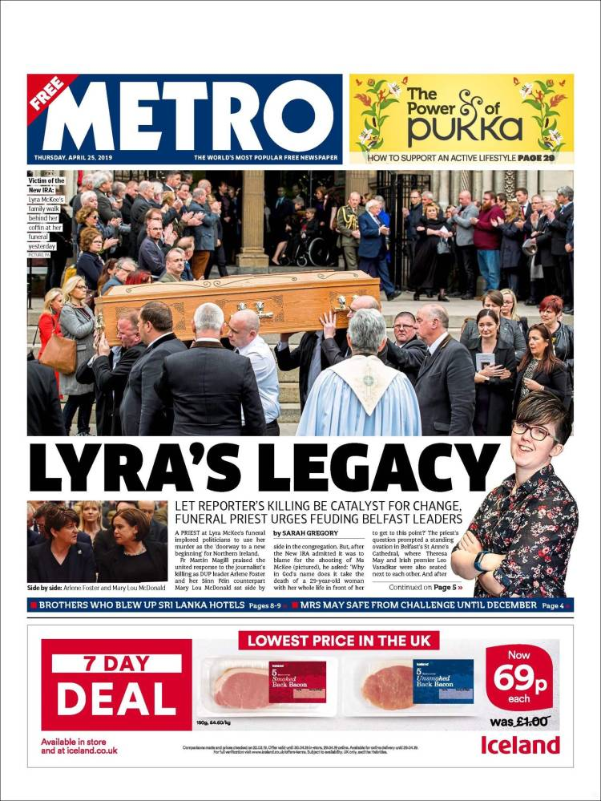
Apply LIAR to both sources (This is OCR’s ‘theoretical framework’)
How does each source follow or subvert genre (generic conventions). Refer to Lacey and Neale?
To what extent does each source illustrate a trend of ‘feminization’ ?

Slide 2
GUARDIAN OR METRO?
Tabloid format but not style
Freesheet
Funded by advertising
Owned by DMG (Daily Mail Group)
Scott Trust/Guardian Media Group
Tabloid mode of address and conventions
Subscription service
Reformers
Lord Rothermere
Commuters
Liberal/centre-left ‘left-leaning’ (Lib-Dems/Labour)
(A)BC1 C2
Mainstreamers
Right-wing, ‘right-leaning’ (Tory, Conservative
ABC1s
Strong tradition of investicative journalism
ANSWERS
GUARDIAN
Scott Trust/Guardian Media Group
Subscription service
‘Compact’ tabloid format but not style
Reformers
Liberal/centre-left ‘left-leaning’ Lib-Dems/Lab
ABC1s
Strong tradition of investicative journalism
METRO Freesheet
Funded by advertising
Owned by DMG (Daily Mail Group)
Lord Rothermere
Trad. Tabloid-style conventions
Commuters
(A)BC1 C2
Mainstreamers
Right-wing, ‘right-leaning’ (Tory, Conservative)

Slide 3
Section 1
Define Moral Panics.
Theorist?
Common scapegoats (‘fold devils’)?
Effects of Moral Panics?
Reasons why propular / populist newspapers producers use Moral Panics?
How do Moral panics link to Gerbner’s ideas on Cultivation Theory and Mean World Syndrome
Section 2
Look at Metro Online, Mail online and the Sun Online and find examples of Moral Panics.
Answer section 1 above this time using evidence from the online versions of the tabloids you have studied.

Slide 4
Media Language Activity A
Find, copy & annotate examples of:
Masthead
Banner headline / banner ad
Skyline – text/box/ ad at the top, usually above masthead
Serif
Sans-serif
Jump/ jumpline
Formal mode of address (‘register’)
Informal mode of address
House style
Anchorage
Banner advert
punning
Body or copy
Sidebar
Standfirst
Tightly cropped close-up
Cross-headline / pullquote
Drop cap
Byline
t. 3 colour palette
Activity B
Match the concepts to the theorists
1 Intertextuality ( & hypperealism – the primacy of fake replica second-hand simulated mediated reality)
2 Narrative disruption
3 Binary Opposition
4 Connotation
5 Hybridity
6 Objectification
7 Patriarchal values
8 Mean World Syndrome & Cultivation Theory
__________________
A Claude Levi-Strauss
B John Berger/ Laura Mulvey
C Van Zoonen
D George Gerbner
E Todorov
F Steve Neale G Baudrillard
H Roland Barthes
Activity C
find examples of any 5 from activity B

Slide 5
REVISION ACTIVITIES
D
Use kiosko.net – copy two contrasting front pages and analyze them using RAIL. Refer to the blue box concepts in your analysis.
E
Find two stories that exemplify the different brand values and ethos of
The Daily Mail/Sun/ or Express vs The Guardian
F
Find examples of stories/conventions that illustrate or explore the following contexts and ideologies:
Consumerism (including health, escape & utopian ideals)
Feminism, sexism (including objectification, Gaze theory, gender performativity gender conditioning)
Racism, islamophobia, anti-semitism
Ethnocentricity, xenophobia, patriotism
Multi-culturalism
Cultivation theory (incl Mean World Syndrome & Moral Panics)

