Slide 1
Year 12 Thursday 4th June
Print news & media indiustries
Focus on The Guardian & News Values
Recap Tuesday’s lesson
Go over media language on Sun Front Cover
Go over Scavenger Hunt section D

Slide 2
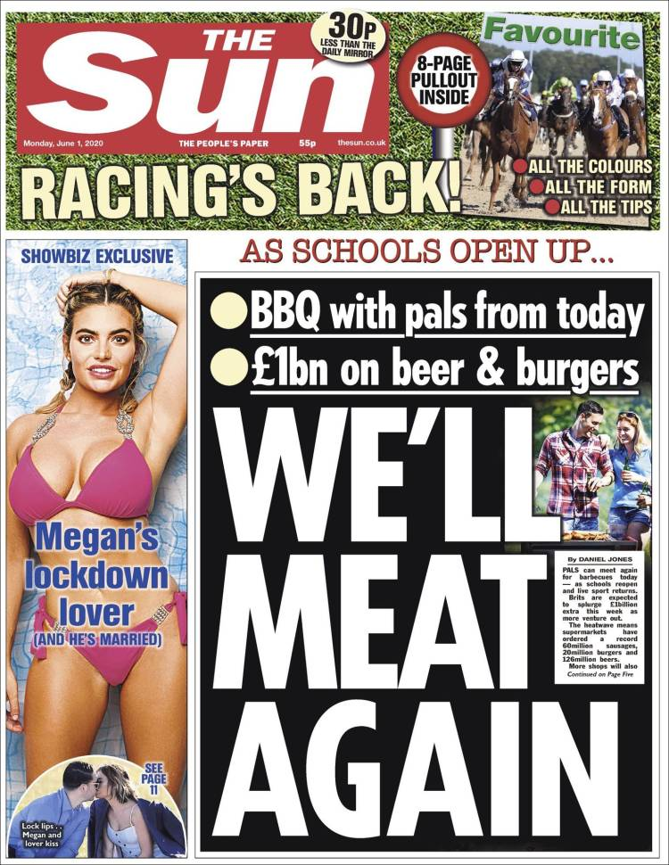
Media language & industries
Industry
Tabloid or broadsheet?
Who owns the Sun?
Rupert Murdoch / News International
How is it funded? No Paywall
What else do they own? The Times, Sky
Hegemonic- owned by a powerful minority
Meaning of ‘media concentration’? News media is owned by a small number of powerful conglomerates
Political affiliation- YES CONS
Links to Bandura? Gerbner?- INFLUENCE OVER TIME THE WAY PEOPLE THINK & BEHAVE ABOUT WOMEN, MINORITIES, REFUGEES
Moral Panics STANLEY COHEN – scapegoating= blaming sections of society for social problems. Works in favour of those in power (male, white elites & conglomerates)
Links to Van Zoonen (patriarchy)- reflects a male-dominated viewpoint
Relevance of Butler- gender performance & conditioning = ‘performativity’

Slide 3
Industry theorists –
check out: Theory zone- OCR theorists
David Hesmonhalgh (corporate dominance and avoiding risk)
Curran & Seaton ( power of media conglomerates, concentration of media ownership; media is controlled by privileged elites; hegemonic rather than pluralist)
Livingstone and Lunt (difficulty of media regulation in a digital age)
For Friday 5th June 4.00pm – do the activities at the end of the OCR theory guides to
Livingstone & Lunt
&
Curran & Seaton

Slide 4
Year 12 exam
These are the OCR theorists you should have some knowledge of
We’ll do a helpful revision activity on this next Tuesday (9th June)
MEDIA LANGUAGE
Todorov
Levi-Strauss
Neale
Baudrillard
Barthes
INDUSTRY
Hesmondhalgh
Curran & Seaton
Livingstone & Lunt
REPRESENTATION
Van Zoonen
Butler
Hall
AUDIENCE
Gerbner
Shirky
Jenkins

Slide 5
UCAS REFERENCE & PERSONAL STATEMENT PREP
1 Which topic have you enjoyed the most in Media Studies ? Why?
2 Is there another area or topic that you would like to do in more detail and depth? Why?
3 What type of work do you enjoy the most in lessons?
e.g. Presentations, note-taking, discussions, pair work, learning games like strip bingo, making materials for corridor display
4 What would you like to have done more of this year (e.g. practical work, making videos, magazines, websites, photoshop work)?
5 What would you like to do post-sixth form – university? Job?
6 Do you think media studies will be useful for what you want to do next? Why/ why not?
7 Has media studies changed the way you think about the media? TV /film /Netflix /radio /social media
8 Have you done / do you plan to / would you like to do work experience based around the media ? Give details

