Slide 1
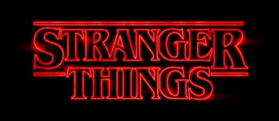
Stranger Things Narrative Structure
Leson aim – look at the narrative structure of E1 and see how it is suited to the long form format
Starter
Who disappears in E1?
What word is used in the title of E1 instead of disappearance? Why?
Mike’s surname?
Mike’s sister?

Slide 2
Long Form TV Dramas allow writers the time and space to develop characters, storylines and themes in more depth and detail.
In Stranger Things, characters, storylines and themes develop more slowly and in more depth over eight episodes.
“We’ll be right back after the break …”
With linear commercial TV, (not Netflix), especially in the US, it was important to bring audiences back after the frequent commercial breaks. So narratives had to be constructed to coinstantly keep audiences coming back for more.
This is also how quiz programmes like Who Wants to Be a Millionaire and Reality Shows keep audiences engaged but also in a sense manipulate them into continuing to watch. So they will be exposed to the programme itself and also the adverts.

Slide 3
EPISODE ONE STORYLINES
A NARRATIVE ARC IS A STORYLINE OR SUBPLOT THAT EXTENDS ACROSS MULTIPLE EPISODES
Main narrative strands outlined in E1. Notice how they interconnect
HAWKINS LAB, PARANORMAL ACTIVITY, COVER UP, STRANGE EVENTS, OPENING UP THE RIFT TO ‘THE UPSIDE DOWN’
THE BOYS, FRIENDSHIP, DUNGEONS & DRAGONS, BIKES ETC
WILL’S EXPERIENCES & DISAPPEARANCE
HOPPER, POLICE STATION, THE SEARCH
JOYCE – SINGLE MUM, HER ANXIETY, JOB
SCHOOL, BULLYING, AV CLUB, GEEKS
NANCY (+ STEVE HARRINGTON), NANCY AT HOME
ELEVEN – enigma codes, mysterious identity, link to the lab, why is she wanted?

Slide 4
Main narrative strands (storylines) or NARRATIVE ARCS
A narrative arc is a storyline which follows a particular character, group of characters or narrative strand.
The episodes of a long form TV drama are made up of a series of overlapping narrative arcs.
Each narrative arc (storyline) generally follows a 3 stage narrative structure. These stages are described by theorists such as Todorov as
1) EQUILIBRIUM (the calm before the storm, everything seems balanced and happy)
2) DISRUPTION – the main phase of a narrative involving conflict, drama, argument, instability. The disruption phase often builds to a climax. Often a dramatic event causes emotions like shock, panic, fear, anxiety.
3) RESOLUTION – harmony, calm, happiness is restored. This can often be temporary (short-lived) or fragile – in the best narratives, there is often a question over whether the restored happiness will last.
This structure is often summarised in the phrase:
“Boy meets girl boy loses girl, boy gets girl back”

Slide 5
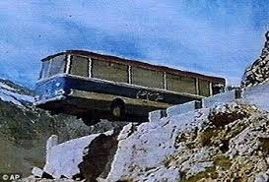
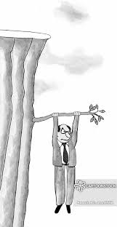
Cliffhangers
Cliffhangers add tension and suspense to a narrative.
In LFTV dramas, an episode will normally end at a point where the resolution (outcome) of a storyline is at a climax. This leaves audiences desperate to know what happens next.
This ending is called a cliffhanger.
In Long form TV dramas, a storyline or narrative arc is usually INTERRUPTED at a key moment and the narrative switches to a different part of the plot. This creates internal cliffhangers. (‘mini-cliffhangers’) Stranger Things is full of examples of the narrative switching focus in this way to create added suspense.
Do these conventions apply to other series you have watched recently?

Slide 6
Look at the plot summary of Stranger Things, Episode 1 and write down
The different storylines (we could also call these narrative strands, narrative arcs or plotlines)
At the end of Episode One, how many questions are left unanswered? – write down in bullet points what the audience are left wondering about.
For Friday – hand in by the end of Friday please.
Make notes on: How does Episode One encourage a range of audiences to continue watching?
This partly involves answers to point B above but also extra codes and conventions such as: aspects of cinematography, location, humour, quality of acting, production values, eighties nostalgia, genre.

Slide 7
Fandom Wiki site on Stranger Things
Great for production details
https://strangerthings.fandom.com/wiki/Stranger_Things/Season_1
Long Form TV Dramas allow writers the time and space to develop characters, storylines and themes in more depth and detail.

